Slide 1

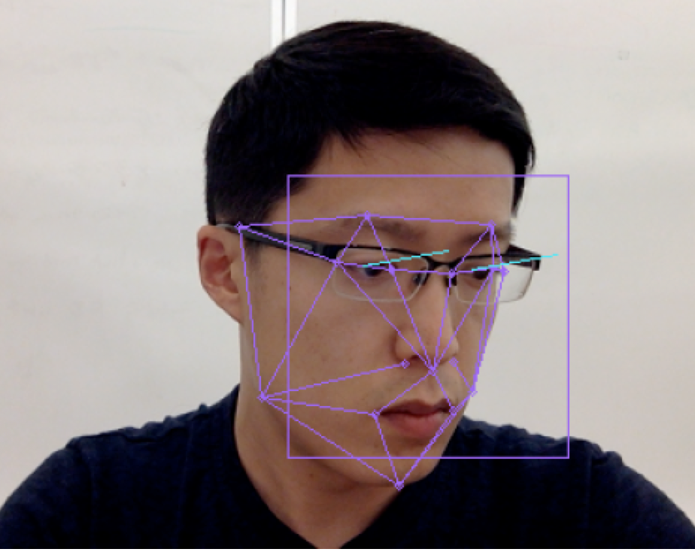
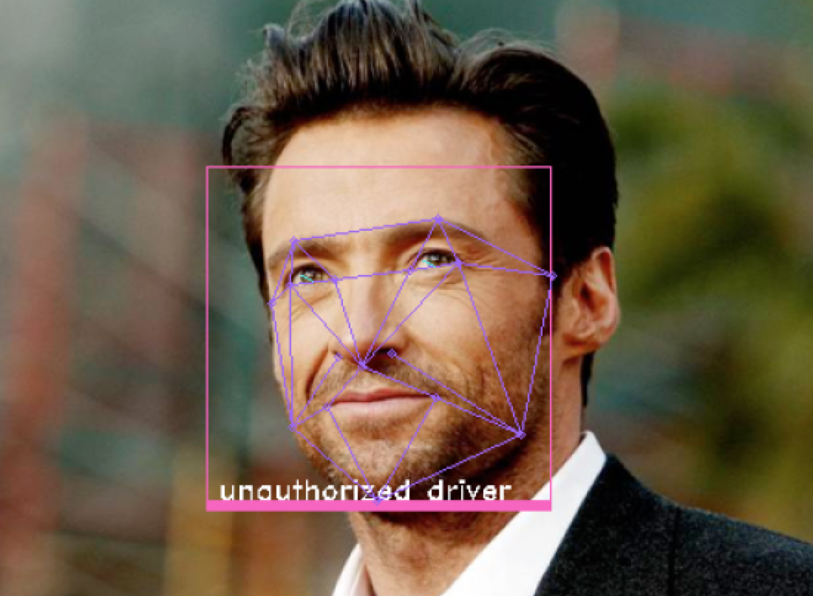
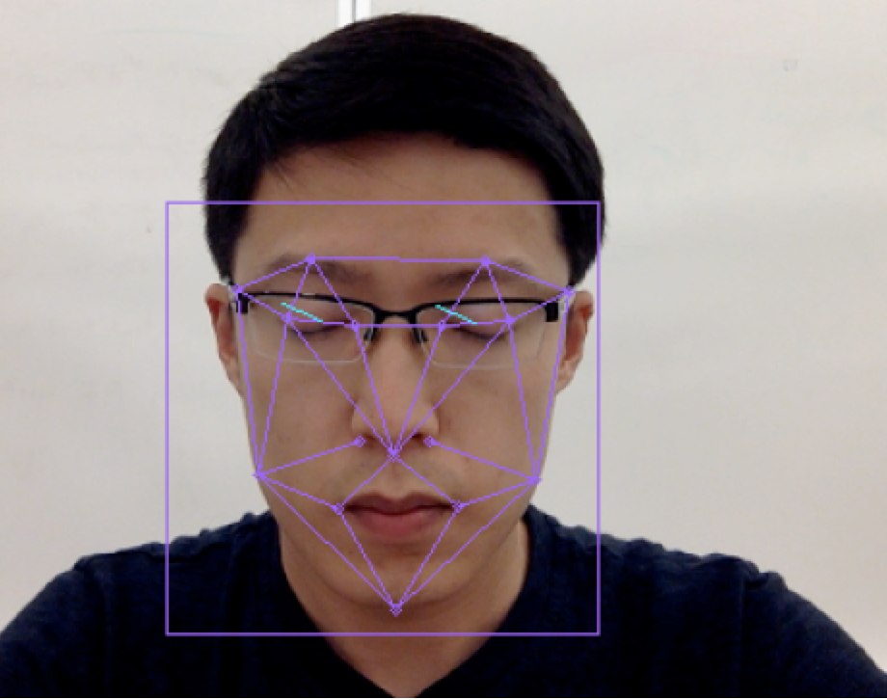
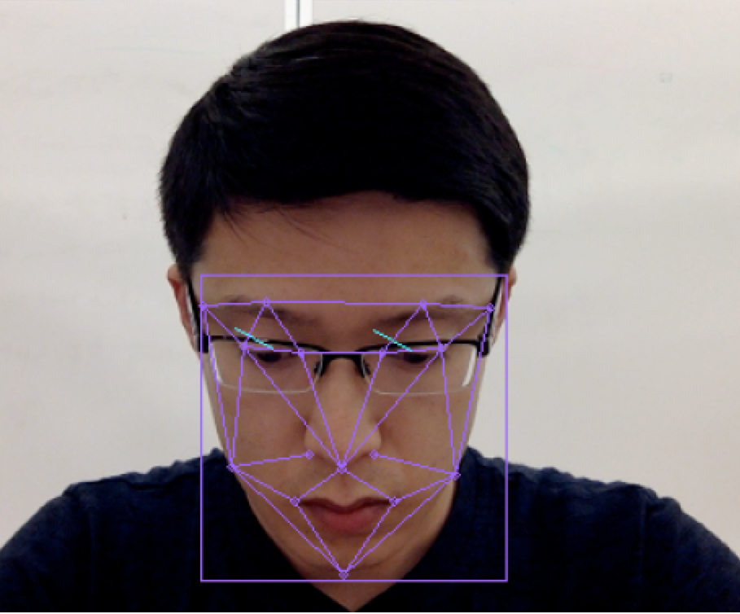
SMARTS Driving Assistant
Face Recognition for Driver Authentication
Real-time Drowsiness and Distraction Detection
In-vehicle Evaluation without Cloud ensures highest Privacy
Friendly alerts help driver stay focused
Unauthorized driver
X Distraction Alert!
Unauthorized Driver
Drowsiness Alert!
Y Distraction Alert!

Slide 2
